Slide 1

Winter Institute in Computational Social Science
Day 3: Digital Traces - APIs
Wednesday January 6th, 2020

Slide 2
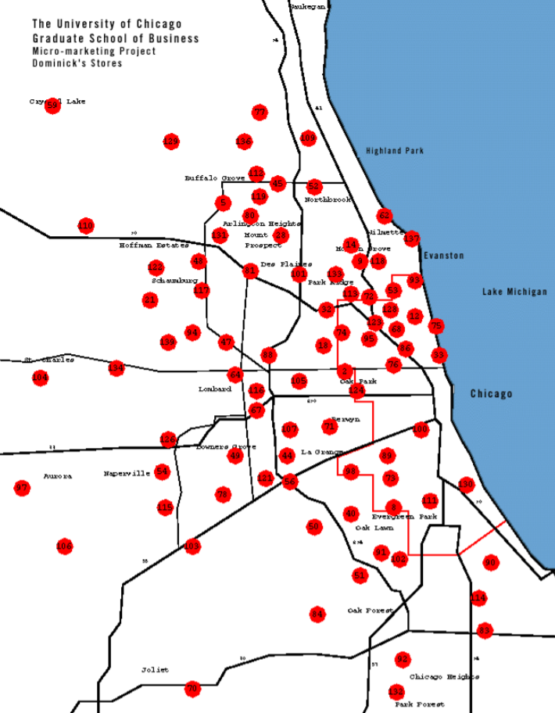
As we go about our lives, traces of our daily activities are being logged in databases
My favorite example
A canonical dataset in the field of Quantitate Marketing is known as “The Dominick’s Dataset”
Collaboration between University of Chicago Booth School of Business & Dominick’s Finer Foods grocery store
Weekly sales and coupon use data from 1989-1997 across 3500 product codes in nearly 100 different stores
Includes a rich set of store-level demographic data from 1990 census
2

Slide 3
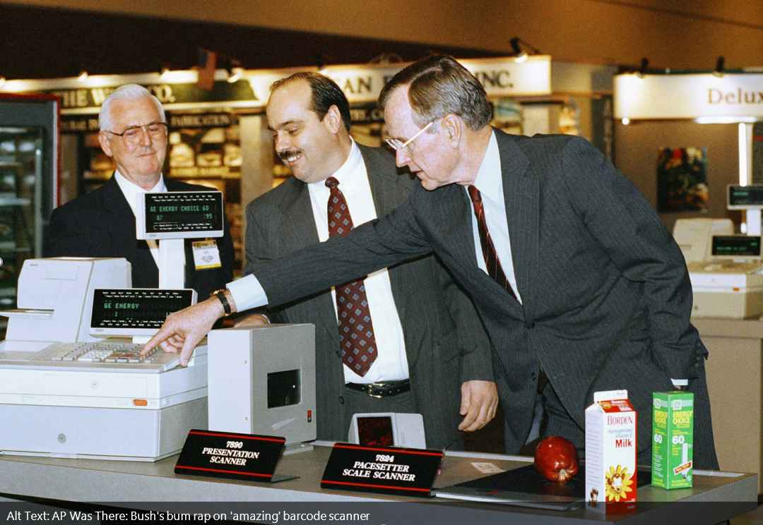
The Dominick’s dataset is, of course, a child of technological progress (i.e., barcode scanners)
For more on scanner technology: Weightman (2015), The History of the Barcode https://www.smithsonianmag.com/innovation/history-bar-code-180956704/

Slide 4
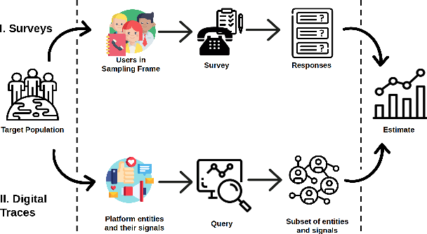
Digital traces are a significant departure from how social scientists typically collect data
Comparison to surveys
Image credit: Sen et al. (2020), Proceedings of the 2020 Conference on Fairness, Accountability, and Transparency https://doi.org/10.1145/3351095.3375669
4

Slide 5
As a subset of observational data, digital traces have a lot to offer social science scholarship
Some unique affordances
Relatively cheap
No participant costs
Often capture more heterogeneity than standard surveys
Retrospective analysis
Can study major world events without planning ahead
Especially useful for the design of natural experiments
External validity
Users are less aware they’re being studied (i.e., nonreactivity)
Behavioral measures of social ties (Golder and Macy 2014)
5

Slide 6
Yet, there are obstacles to making digital traces an integral part of social science progress
A measured tone
Big does not mean all
Who is over/under-represented? (boyd and Crawford 2012)
What is/isn’t being measured? (Lazer 2015)
Platforms motivate certain behaviors
They may alter what we want to measure (Jungherr 2018)
They ‘perform’ popularized social theories (Healy 2015)
Large datasets can encourage data mining
HARKing: Hypothesizing After Results are Known (Kerr 1998)
Especially true for social network metrics (Webber et al. 2020)
6
Notes:
wan

Slide 7
How do we reconcile the tension between theory testing and exploratory data analysis?
My personal take
The scientific process is often iterative
Empirical analysis can help with theory development
Implicit theorizing guides our empirical decision-making
Data linking can help overcome some limits of digital traces
Survey/experiment data can be added to fill conceptual gaps
Offline data can be used to add context to online data
Interdisciplinary collaboration can help to shorten the process
One of my dissertation chapters took 7 years to publish
A recent collaboration tells a more encouraging story..
7

Slide 8
One of my recent papers gained from iterating between theory development and analysis
Social Norms and the Dynamics of Online Incivility
I was initially interested in understanding how discussions between two people can change in the presence of a third.
The data in Rains et al. (2017) seemed ideal for the analysis I had in mind. I reached out and they kindly shared the data.
The data were not quite what I expected, but captured third parties in a different way - social ratings (i.e., Up/down votes).
We wrote a paper with interesting findings but no unified theory – reviewers pushed back, suggesting we read up on social norms.
Steve Rains shared a relevant theory he learned in grad school, which helped to unify our findings. The paper was just accepted.
This would have taken much longer (or not happened) by myself!
8

Slide 9
Social Norms and the Dynamics of Online Incivility
Yotam Shmargad, Kate Kenski, Steve Rains (University of Arizona)
Kevin Coe (University of Utah)
Forthcoming in Social Science Computer Review

Slide 10
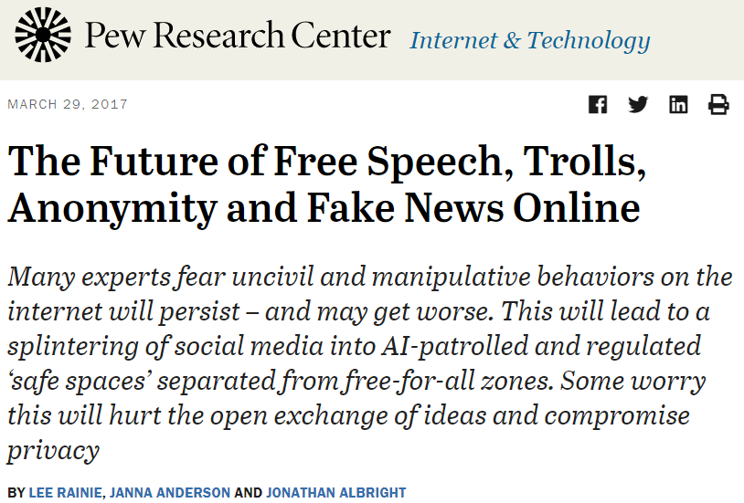
The internet has resurrected concerns about the state of political discourse
Forms of anti-social commenting
Incivility (Coe et al. 2014, Jamieson et al. 2017)
Prejudice (Hsueh et al. 2015, Munger 2016)
Trolling (Phillips 2015, Stewart et al. 2018)
Hate Speech (Davidson et al. 2017, Álvarez-Benjumea & Winter 2018)
10

Slide 11

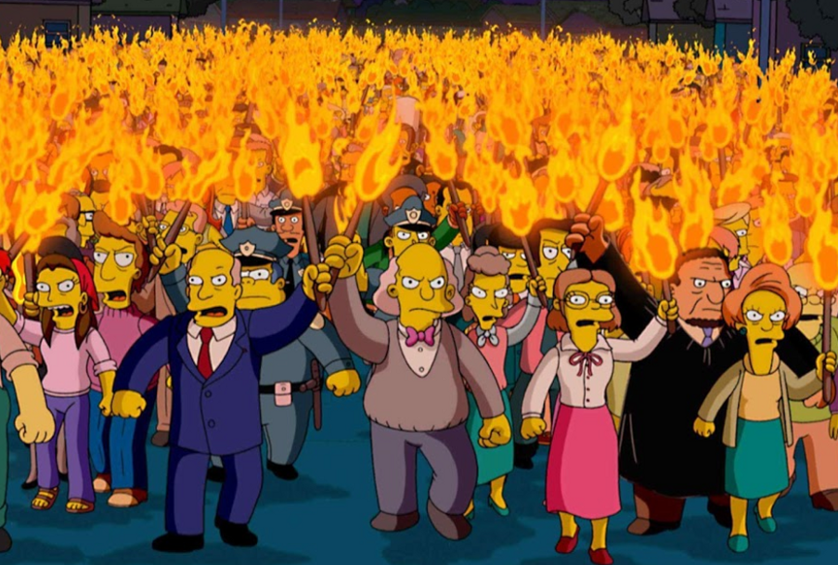
One platform affordance that could shape civil discourse is its rating system (i.e., Likes/Votes)
Puzzle: Do rating systems lead to..
Moderation of incivility?
Perpetuation of incivility?
Conditioning (Skinner 1938)
Social norms (Coleman 1990)
Flaming (Hmielowski et al. 2014)
Backlash (Cheng et al. 2014)
11

Slide 12
Online rating systems inform users about the social norms of a community
Theoretical framework
Injunctive norms refer to what people should do, while descriptive norms capture how people actually behave (Cialdini et al. 1990)
Theory of normative social behavior: descriptive and injunctive norms interact in shaping behavior (Rimal and Real 2003, 2005)
“When people perceive that social sanctions exist for noncompliance, they are more likely to conform if they also perceive that the behavior is widespread among their peers” (Lapinski and Rimal 2005; italics added)
Such an interaction predicts alcohol use (Lee et al. 2007), political petition signing (Smith & Louis 2008), and handwashing among childcare workers (Lapinski et al. 2014), among other behaviors
12

Slide 13
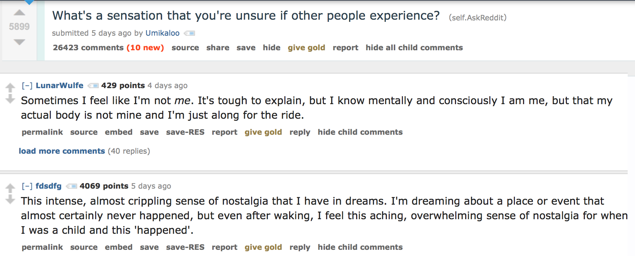
We capture injunctive norms with votes and descriptive norms with proximate comments
Operationalizing norms
We thus create a mapping of important social science constructs onto behavioral trace data (Lazer 2015)
13

Slide 14
We analyze > 6,000 comments on AZ Daily Star news articles over a three week span in 2011
Data collection and preparation
314 news articles across 8 sections (Business, Entertainment, Lifestyle, Local, National/World, Opinion, Sports, State)
Comments were manually coded for 5 incivility measures (Name calling, Vulgarity, Aspersion, Lying, Pejorative for speech)
Each comment includes information about both 1) the specific news article and 2) the specific commenter
For each comment, we define a network link between the commenter and the person who commented right after them
14

Slide 15
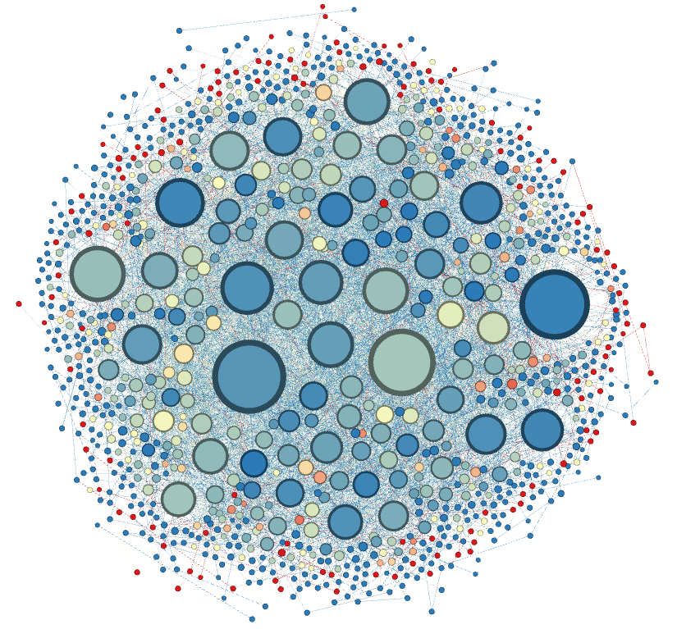
By defining links between commenters, we can visualize the social network of the community
Collective norms (Lapinski and Rimal 2005)
There are no trolls
(i.e., no large red nodes)
Users regularly comment across news articles
(i.e., network does not break into article-specific clusters)
There is individual-level heterogeneity in incivility (i.e., many nodes are neither blue nor red)
15

Slide 16
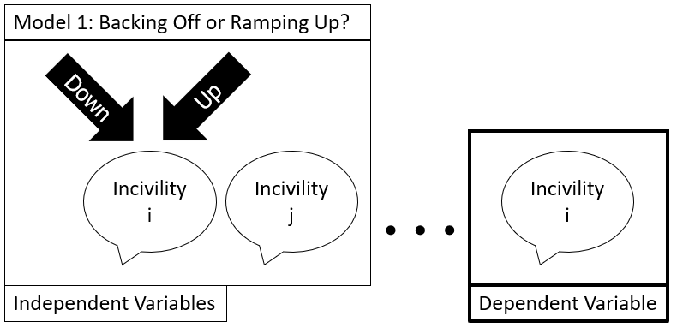
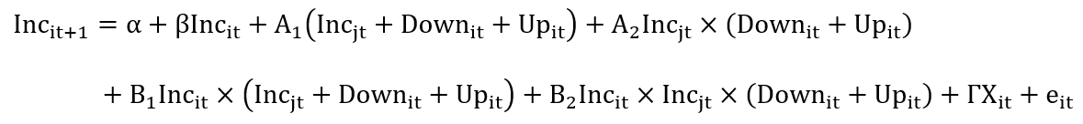
We first model whether an initial commenter will be uncivil in their subsequent comment
16

Slide 17
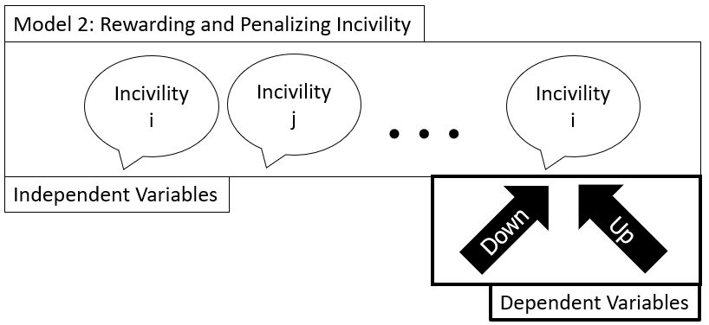
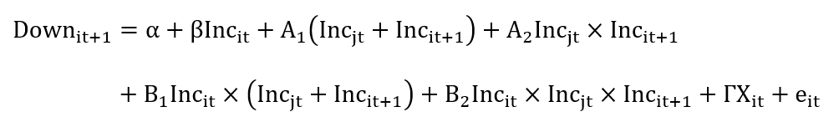
Next, we model the number of votes received on the last comment in the chain
17

Slide 18
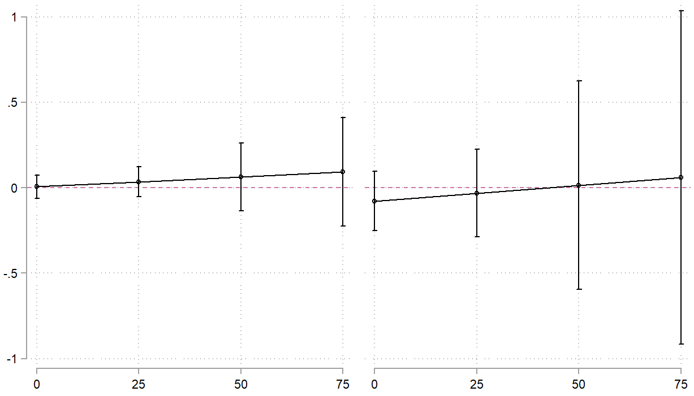
Down votes do not shape the effect of incivility in the proximate comment
Initial Civility
Initial Incivility
Effect of Proximate Incivility on Subsequent Incivility
Number of Down Votes Received

Slide 19
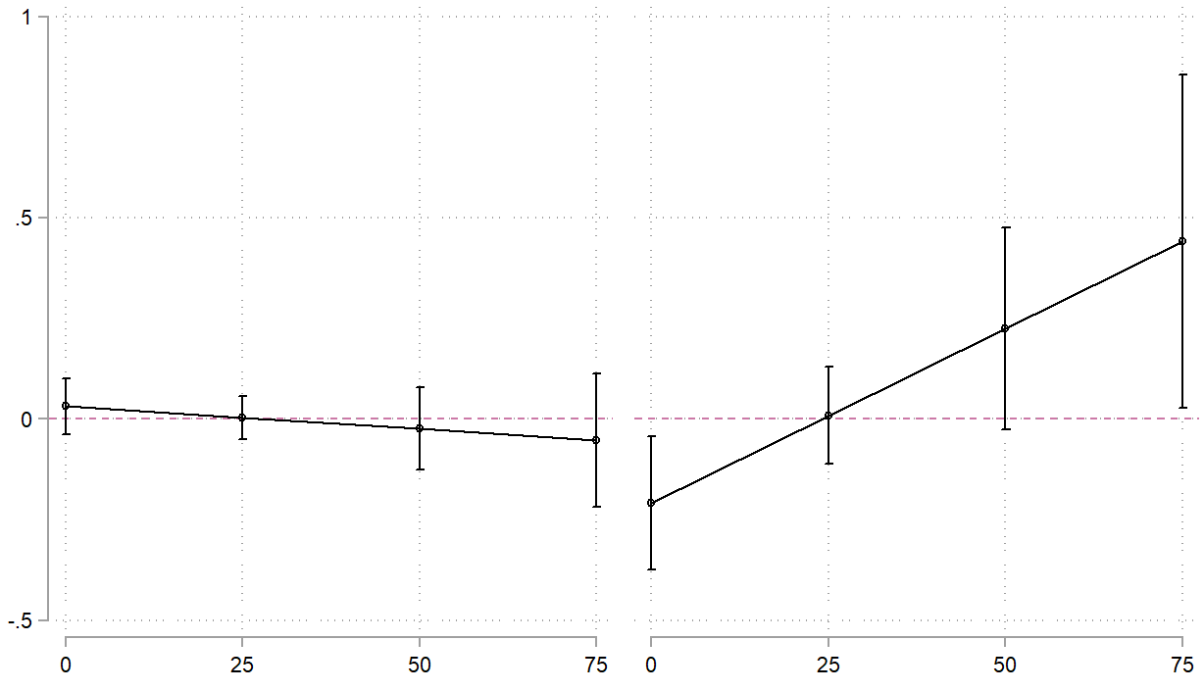
However, up votes do shape how uncivil commenters respond when met with incivility
Initial Civility
Initial Incivility
perpetuation
Effect of Proximate Incivility on Subsequent Incivility
moderation
Number of Up Votes Received

Slide 20
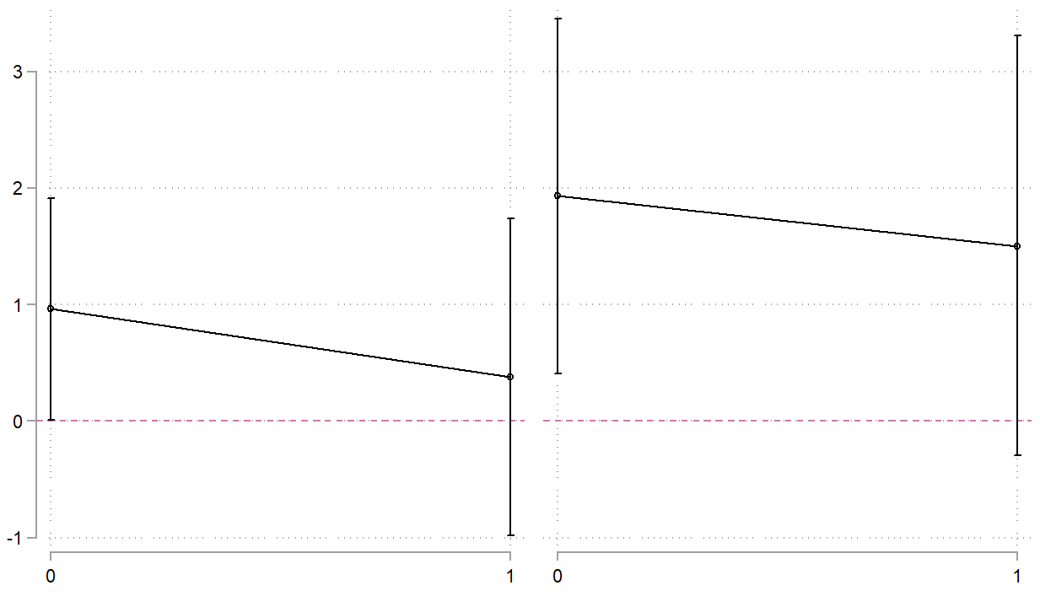
Incivility is penalized with more down votes, regardless of initial or proximate incivility
Initial Civility
Initial Incivility
Effect of Subsequent Incivility on Number of Down Votes
Proximate Civility
Proximate Incivility
Proximate Civility
Proximate Incivility

Slide 21
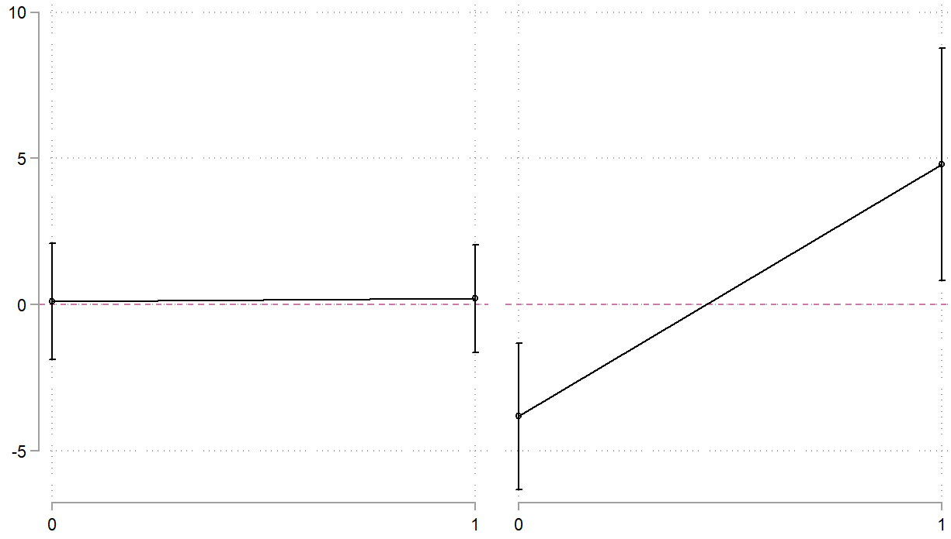
Incivility is rewarded with more up votes in an uncivil context, but penalized in a civil context
Initial Civility
Initial Incivility
Effect of Subsequent Incivility on Number of Up Votes
Entertainment?
Self-defense?
Appropriateness?
Proximate Civility
Proximate Incivility
Proximate Civility
Proximate Incivility

Slide 22
Online incivility is contextual, and sensitive to both positive feedback and proximate incivility
Mapping traces to constructs
Digital traces |  | Social science constructs
Proximate comments | ←→ | Descriptive norms
Social ratings | ←→ | Injunctive norms
Text features | ←→ | Incivility/Toxicity
With some ingenuity, we can capture these constructs on Reddit with the help of Google’s Perspective API
22

Slide 23
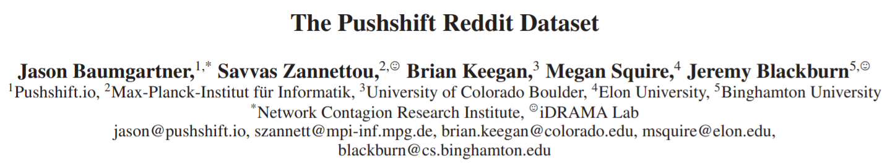
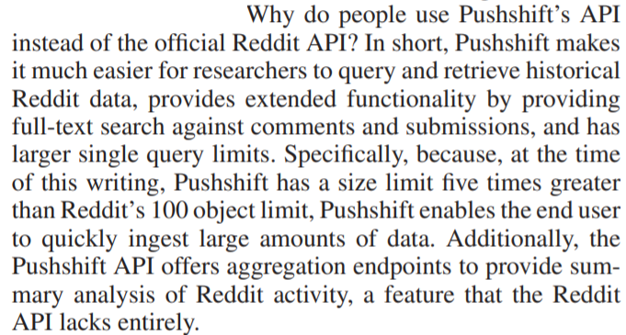
While Reddit has an API, the Pushshift API has some advantages (as well as disadvantages)
Excerpt from a 2020 paper about Pushshift
23

Slide 24
Winter Institute in Computational Social Science
Day 3: Digital Traces - APIs
Wednesday January 6th, 2020

